Slide 1
SWING

Slide 2
SWING
Swing is a part of Java Foundation Classes (JFC) that is used to create window-based applications. It is built on the top of AWT (Abstract Windowing Toolkit) API and entirely written in java.
Unlike AWT, Java Swing provides platform-independent and lightweight components.
The javax.swing package provides classes for java swing API such as
1. Jbutton
2. JTextField
3. JTextArea
4. JRadioButton
5. Jcheckbox
6. Jmenu
7.JColorChooser etc.

Slide 3
Difference between AWT and Swing
No. | Java AWT | Java Swing
1) | AWT components are platform-dependent. | Java swing components are platform-independent.
2) | AWT components are heavyweight. | Swing components are lightweight.
3) | AWT doesn't support pluggable look and feel. | Swing supports pluggable look and feel.
4) | AWT provides less components than Swing. | Swing provides more powerful components such as tables, lists, scrollpanes, colorchooser, tabbedpane etc.
5) | AWT doesn't follows MVC(Model View Controller) where model represents data, view represents presentation and controller acts as an interface between model and view. | Swing follows MVC.

Slide 4
What is JFC
The Java Foundation Classes (JFC) are a set of GUI components which simplify the development of desktop applications.

Slide 5
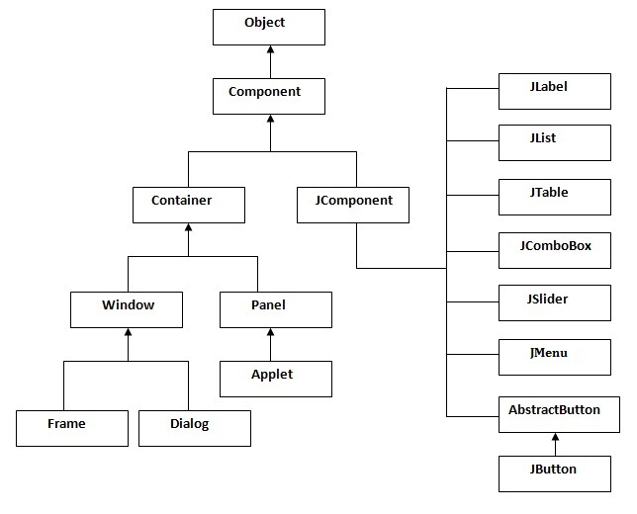
Hierarchy of Java Swing classes

Slide 6
Commonly used Methods of Component class
Method | Description
public void add(Component c) | add a component on another component.
public void setSize(int width,int height) | sets size of the component.
public void setLayout(LayoutManager m) | sets the layout manager for the component.
public void setVisible(boolean b) | sets the visibility of the component. It is by default false.

Slide 7
Swing Examples
1. By creating the object of Frame class (association)
2. By extending Frame class (inheritance)

Slide 8
Note
We can write the code of swing inside the main(), constructor or any other method.

Slide 9
Simple Java Swing Example
public class FirstSwingExample {
public static void main(String[] args) {
JFrame f=new JFrame();//creating instance of JFrame
JButton b=new JButton("click");//creating instance of JButton
b.setBounds(130,100,100, 40);//x axis, y axis, width, height
f.add(b);//adding button in JFrame
f.setSize(400,500);//400 width and 500 height
f.setLayout(null);//using no layout managers
f.setVisible(true);//making the frame visible
}
}

Slide 10
Example of Swing by Association inside constructor
public class Simple {
JFrame f;
Simple(){
f=new JFrame();//creating instance of JFrame
JButton b=new JButton("click");//creating instance of JButton
b.setBounds(130,100,100, 40);
f.add(b);//adding button in JFrame
f.setSize(400,500);//400 width and 500 height
f.setLayout(null);//using no layout managers
f.setVisible(true);//making the frame visible
}
public static void main(String[] args) {
new Simple();
}
}

Slide 11
Simple example of Swing by inheritance
public class Simple2 extends JFrame{//inheriting JFrame
JFrame f;
Simple2(){
JButton b=new JButton("click");//create button
b.setBounds(130,100,100, 40);
add(b);//adding button on frame
setSize(400,500);
setLayout(null);
setVisible(true);
}
public static void main(String[] args) {
new Simple2();
}}

Slide 12
LayoutManagers

Slide 13
Layout Managers
The LayoutManagers are used to arrange components in a particular manner. LayoutManager is an interface that is implemented by all the classes of layout managers. There are following classes that represents the layout managers:
java.awt.BorderLayout
java.awt.FlowLayout
java.awt.GridLayout
java.awt.CardLayout
java.awt.GridBagLayout
javax.swing.BoxLayout
javax.swing.GroupLayout
javax.swing.ScrollPaneLayout
javax.swing.SpringLayout etc.

Slide 14
BorderLayout
The BorderLayout is used to arrange the components in five regions: north, south, east, west and center. Each region (area) may contain one component only. It is the default layout of frame or window. The BorderLayout provides five constants for each region:
public static final int NORTH
public static final int SOUTH
public static final int EAST
public static final int WEST
public static final int CENTER

Slide 15
Constructors of BorderLayout class
BorderLayout(): creates a border layout but with no gaps between the components.
JBorderLayout(int hgap, int vgap): creates a border layout with the given horizontal and vertical gaps between the components.

Slide 16
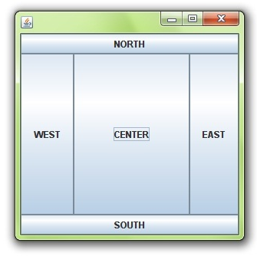
Example of BorderLayout class

Slide 17
JButton Example
public class Border {
JFrame f;
Border(){
f=new JFrame();
JButton b1=new JButton("NORTH");;
JButton b2=new JButton("SOUTH");;
JButton b3=new JButton("EAST");;
JButton b4=new JButton("WEST");;
JButton b5=new JButton("CENTER");;
f.add(b1,BorderLayout.NORTH);
f.add(b2,BorderLayout.SOUTH);
f.add(b3,BorderLayout.EAST);
f.add(b4,BorderLayout.WEST);
f.add(b5,BorderLayout.CENTER);
f.setSize(300,300);
f.setVisible(true);
}
public static void main(String[] args) {
new Border();
} }

Slide 18
GridLayout
The GridLayout is used to arrange the components in rectangular grid. One component is displayed in each rectangle.

Slide 19
Constructors of GridLayout class
GridLayout(): creates a grid layout with one column per component in a row.
GridLayout(int rows, int columns): creates a grid layout with the given rows and columns but no gaps between the components.
GridLayout(int rows, int columns, int hgap, int vgap): creates a grid layout with the given rows and columns alongwith given horizontal and vertical gaps.

Slide 20
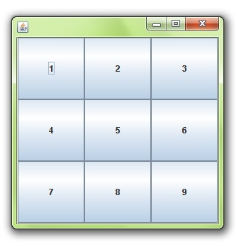
Grid Layout

Slide 21
GridLayout
public class MyGridLayout {
JFrame f;
MyGridLayout() {
f = new JFrame();
JButton b1 = new JButton("1");
JButton b2 = new JButton("2");
JButton b3 = new JButton("3");
JButton b4 = new JButton("4");
JButton b5 = new JButton("5");
JButton b6 = new JButton("6");
JButton b7 = new JButton("7");
JButton b8 = new JButton("8");
JButton b9 = new JButton("9");
f.add(b1); f.add(b2); f.add(b3); f.add(b4); f.add(b5); f.add(b6); f.add(b7); f.add(b8); f.add(b9);
f.setLayout(new GridLayout(3, 3));
f.setSize(300, 300);
f.setVisible(true);
}
public static void main(String[] args) {
new MyGridLayout();
} }

Slide 22
FlowLayout
The FlowLayout is used to arrange the components in a line, one after another (in a flow). It is the default layout of applet or panel.

Slide 23
Fields of Flow Layout Class
public static final int LEFT
public static final int RIGHT
public static final int CENTER
public static final int LEADING
public static final int TRAILING

Slide 24
Constructors of FlowLayout class
FlowLayout(): creates a flow layout with centered alignment and a default 5 unit horizontal and vertical gap.
FlowLayout(int align): creates a flow layout with the given alignment and a default 5 unit horizontal and vertical gap.
FlowLayout(int align, int hgap, int vgap): creates a flow layout with the given alignment and the given horizontal and vertical gap.

Slide 25
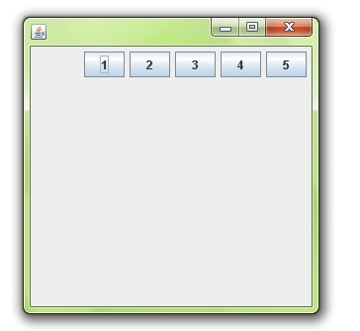
Flow Layout

Slide 26
Example of FlowLayout
public class MyFlowLayout{
JFrame f;
MyFlowLayout(){
f=new JFrame();
JButton b1=new JButton("1");
JButton b2=new JButton("2");
JButton b3=new JButton("3");
JButton b4=new JButton("4");
JButton b5=new JButton("5");
f.add(b1);f.add(b2);f.add(b3);f.add(b4);f.add(b5);
f.setLayout(new FlowLayout(FlowLayout.RIGHT));
//setting flow layout of right alignment
f.setSize(300,300);
f.setVisible(true);
}
public static void main(String[] args) {
new MyFlowLayout();
} }

Slide 27
BoxLayout class
The BoxLayout is used to arrange the components either vertically or horizontally. For this purpose, BoxLayout provides four constants. They are as follows:

Slide 28
Note
BoxLayout class is found in javax.swing package.

Slide 29
Fields of BoxLayout class
public static final int X_AXIS
public static final int Y_AXIS
public static final int LINE_AXIS
public static final int PAGE_AXIS

Slide 30
Constructor of BoxLayout class:
BoxLayout(Container c, int axis): creates a box layout that arranges the components with the given axis.

Slide 31
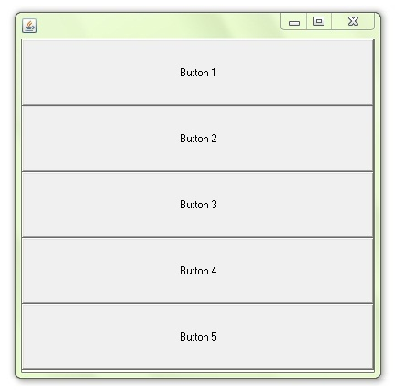
Box Layout

Slide 32
BoxLayout Example1
public class BoxLayoutExample1 extends Frame {
Button buttons[];
public BoxLayoutExample1 () {
buttons = new Button [5];
for (int i = 0;i<5;i++) {
buttons[i] = new Button ("Button " + (i + 1));
add (buttons[i]);
}
setLayout (new BoxLayout (getContentPane(), BoxLayout.Y_AXIS));
setSize(400,400);
setVisible(true);
}
public static void main(String args[]){
BoxLayoutExample1 b=new BoxLayoutExample1();
} }

Slide 33
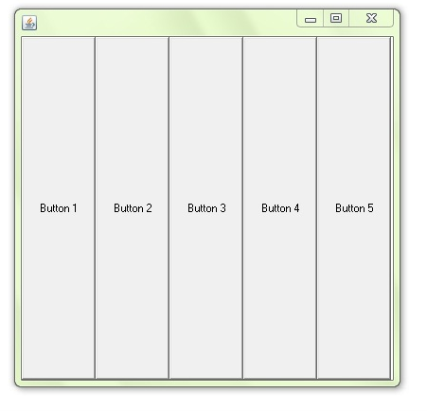
Example 2

Slide 34
BoxLayout Example2
public class BoxLayoutExample2 extends Frame {
Button buttons[];
public BoxLayoutExample2 () {
buttons = new Button [5];
for (int i = 0;i<5;i++) {
buttons[i] = new Button ("Button " + (i + 1));
add (buttons[i]);
}
setLayout (new BoxLayout (getContentPane(), BoxLayout.X_AXIS));
setSize(400,400);
setVisible(true);
}
public static void main(String args[]){
BoxLayoutExample2 b=new BoxLayoutExample2();
} }

Slide 35
CardLayout class
The CardLayout class manages the components in such a manner that only one component is visible at a time. It treats each component as a card that is why it is known as CardLayout.

Slide 36
Constructors of CardLayout class
CardLayout(): creates a card layout with zero horizontal and vertical gap.
CardLayout(int hgap, int vgap): creates a card layout with the given horizontal and vertical gap.

Slide 37
Commonly used methods of CardLayout class
public void next(Container parent): is used to flip to the next card of the given container.
public void previous(Container parent): is used to flip to the previous card of the given container.
public void first(Container parent): is used to flip to the first card of the given container.
public void last(Container parent): is used to flip to the last card of the given container.
public void show(Container parent, String name): is used to flip to the specified card with the given name.

Slide 38
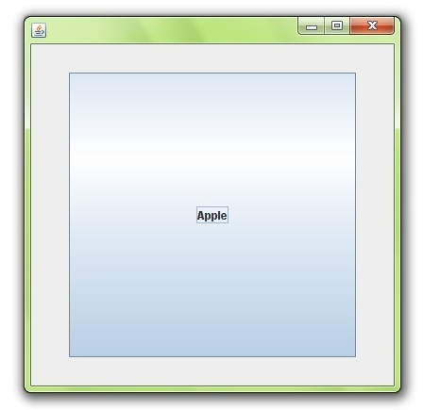
CardLayout

Slide 39
Example of CardLayout
public class CardLayoutExample extends JFrame implements ActionListener{
CardLayout card;
JButton b1,b2,b3;
Container c;
CardLayoutExample(){
c=getContentPane();
card=new CardLayout(40,30);
//create CardLayout object with 40 hor space and 30 ver space
c.setLayout(card);
b1=new JButton("Apple"); b2=new JButton("Boy"); b3=new JButton("Cat");
b1.addActionListener(this); b2.addActionListener(this); b3.addActionListener(this);
c.add("a",b1);c.add("b",b2);c.add("c",b3);
}
public void actionPerformed(ActionEvent e) {
card.next(c);
}
public static void main(String[] args) {
CardLayoutExample cl=new CardLayoutExample();
cl.setSize(400,400);
cl.setVisible(true);
cl.setDefaultCloseOperation(EXIT_ON_CLOSE);
} }

